Slide 1
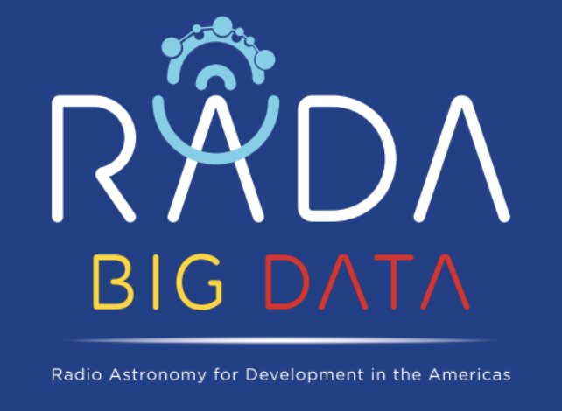
Radiotherapy and Big Data
Dr. Eliana Vasquez Osorio
eliana.vasquezosorio@manchester.ac.uk
Dr. Andrew Green
andrew.green-2@manchester.ac.uk
16-20 March 2020 Medellín, Colombia

Slide 2
Short background in Radiotherapy
… and where can big data make a difference?

Slide 3
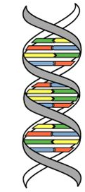
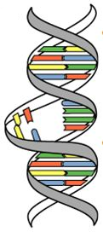
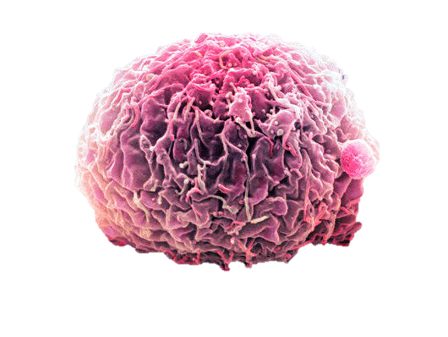
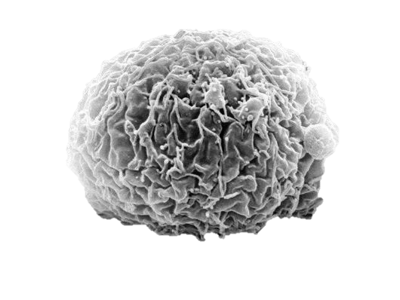
Radiotherapy
Treating cancer using radiation.
Radiation kills cells by damaging their DNA.
Cell
DNA
Notes:
Radiotherapy aims to treat cancer and other diseases with radiation.
It works by damaging the DNA material of the cells that are exposed to radiation.
or
Radiation kills cells by damaging their DNA.
Images from:
http://www.royalsurrey.nhs.uk/What-is-radiotherapy & http://www.sciencephoto.com/media/254147/enlarge

Slide 4
Radiotherapy
Treating cancer using radiation.
Radiation kills cells by damaging their DNA.
Cancer cells are more sensitive to radiation than healthy cells.
BUT both types are damaged by radiation.
Challenge! limit the radiation to tumor region.
Cell
DNA
Notes:
These damaged cells are then eliminated by the body.
Even though cancer cells are more sensitive to radiation than healthy cells, both types are damaged by radiation
Therefore, in order to reduce damage to healthy organs, the radiation should be limited as close as possible to the tumor area.
In order to identify the tumor area and try and restrict the radiation to this zone, medical images are used.
Images from:
http://www.royalsurrey.nhs.uk/What-is-radiotherapy & http://www.sciencephoto.com/media/254147/enlarge

Slide 5
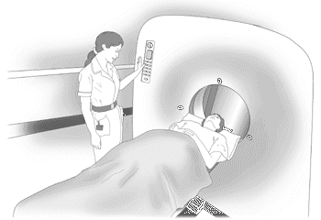
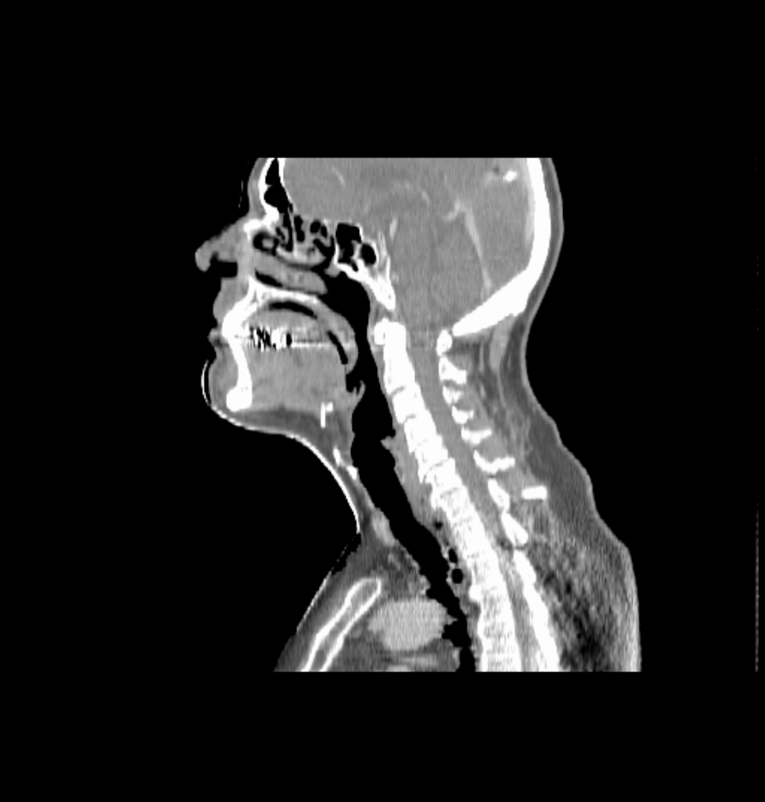
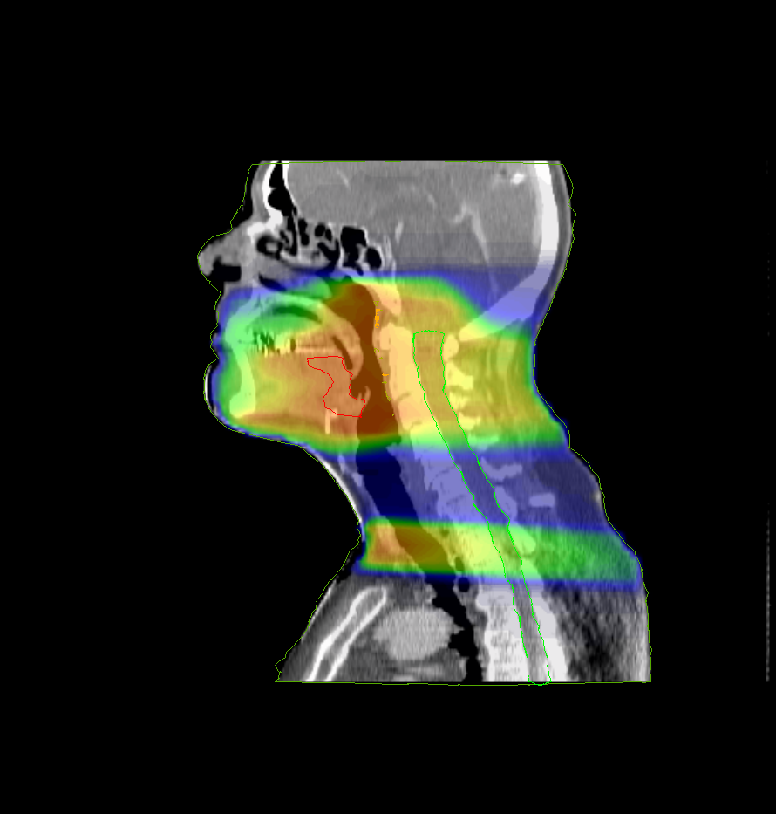
Radiotherapy: planning a treatment
Computed Tomography scanner
Notes:
In this slide, a Computed Tomography scan of a H&N cancer patient is shown next to an illustration of a CT scanner.
[CLICK]
The image is used to identify the tumor, here in red, and organs that should be protected from high doses. For example the spinal cord, here in pink.
Using the image and the defined organs, the radiation dose is optimized.
[CLICK]
Here you see the radiation dose given to this patient. Hot colors represent high doses of radiation, while cold colors low doses.
Using some images from http://www.cee.hw.ac.uk/~diana/paccit/webdemo5/demopersonal.html

Slide 6
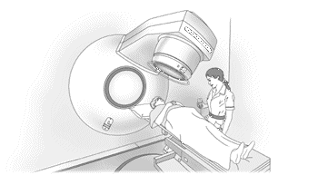

Radiotherapy: delivering a treatment
1
2
3
. . . . . . . .
4
Treatment machine: Linear Accelerator
. . . . . . . .
n
n: treatment days or fractions
Notes:
The radiation dose is then delivered to the patient spread over several days, using, for example, a linear accelerator, here in the left.
To assure that the dose reaches the areas as planned, the patients are placed in the same way, every day.
Using some images from http://www.cee.hw.ac.uk/~diana/paccit/webdemo5/demopersonal.html

Slide 7
Simplified Radiotherapy Pathway
Tumour and organ segmentation
Treatment plan
Treatment delivery
Follow-Up

Slide 8
Some examples where big data can make a difference in radiotherapy
Tumour and organ segmentation
Treatment plan
Treatment delivery
Follow-Up
Automatic [tumour and organ] segmentation
Automatic planning
Identification of radio-sensitive regions
Linac log analysis to predict machine failure
Prediction of failure/relapse and decide on follow-up strategies.

Slide 9
Workshop project
Aim: identify radio-sensitive anatomical regions by analysing data from hundreds of patients treated in the past.

Slide 10
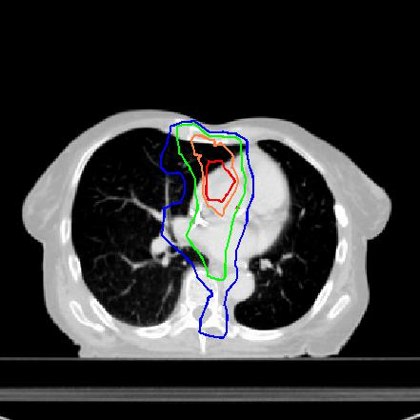
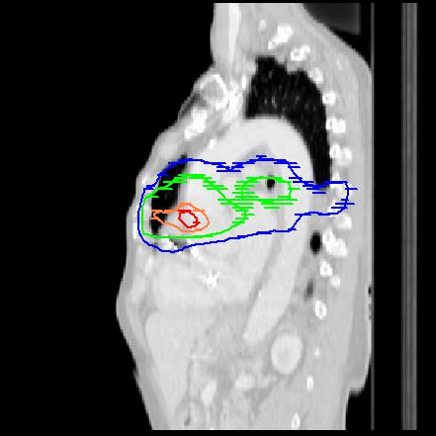
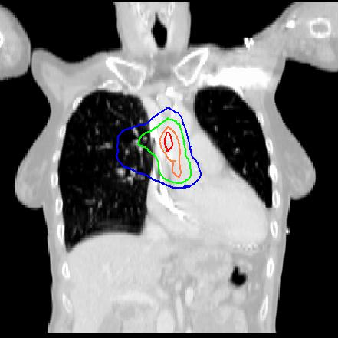
Background: Heart radio-sensitivity
Radiation to heart base linked with poorer survival in lung cancer patients
Results for 1101 unselected NSCLC patients, 55Gy in 20 fractions, overall survival 12 m
McWilliam et al. 2017, ejc 85:106-113

Slide 11
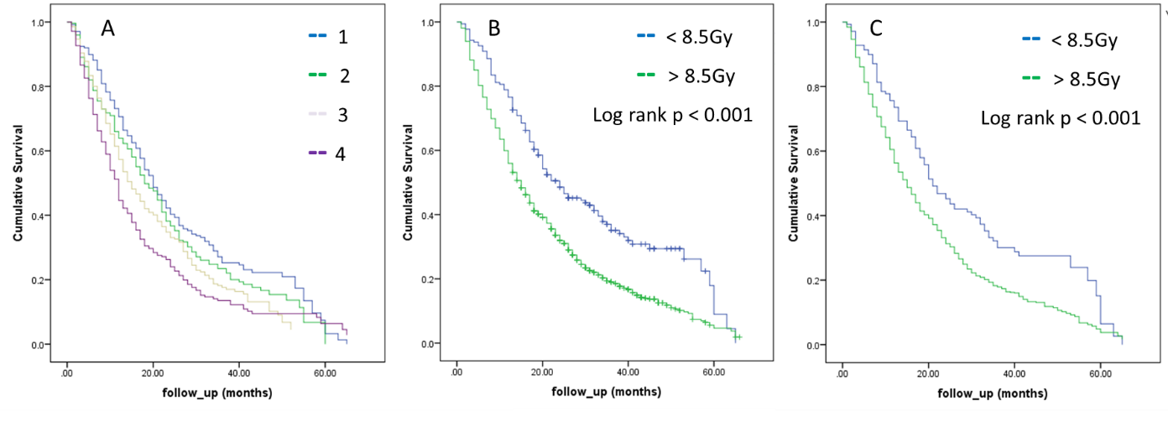
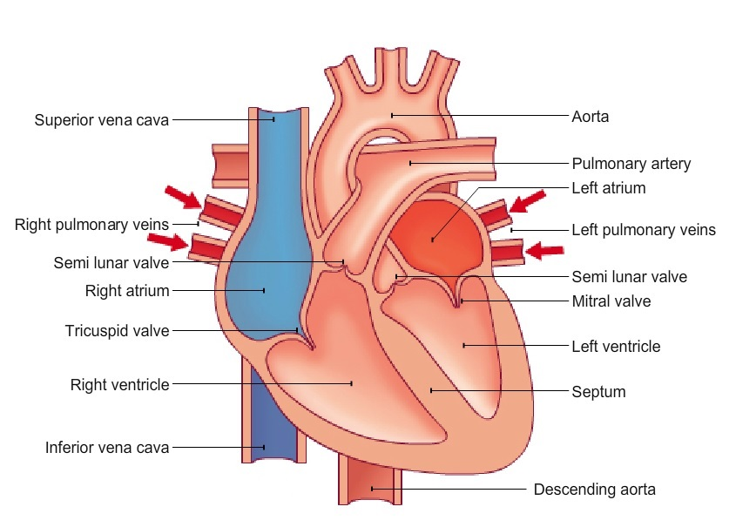
Kaplan Meier curves
1101 patients
Split on 1st Quartile dose to region
8.5Gy
Base of the heart
Notes:
Hazard ratio of 1.2

Slide 12
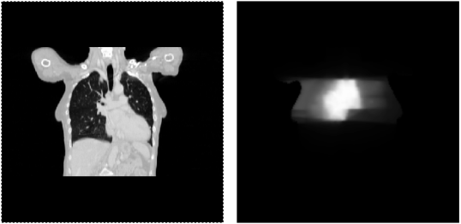
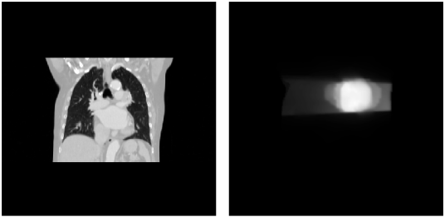
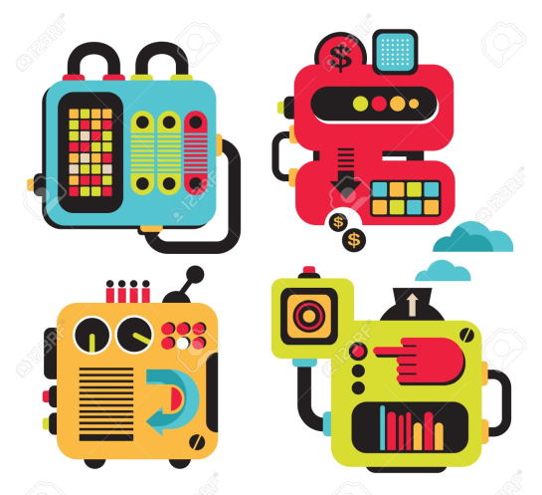
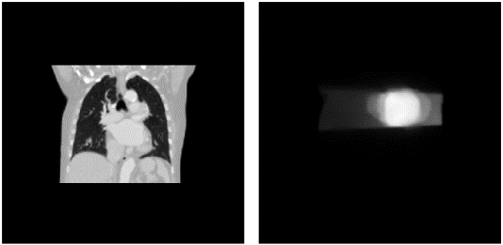
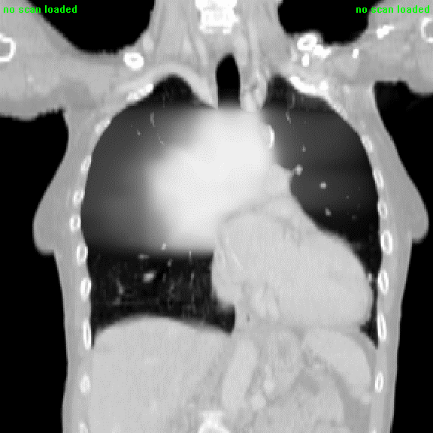
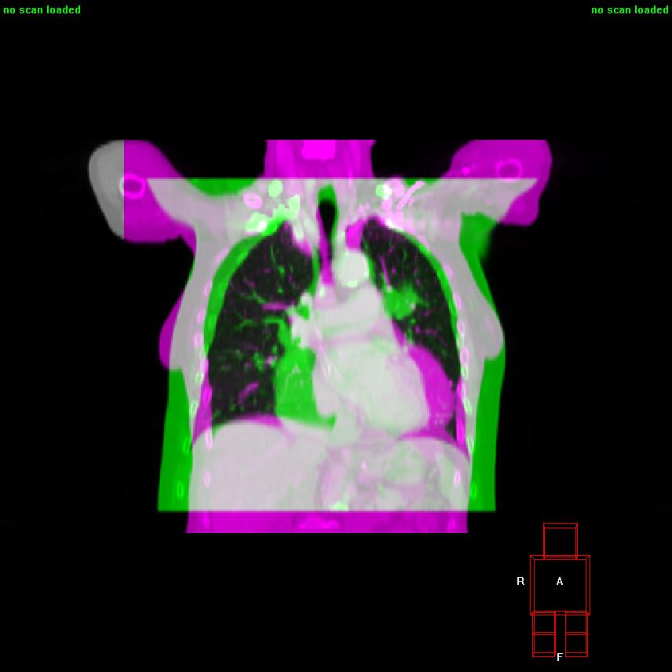
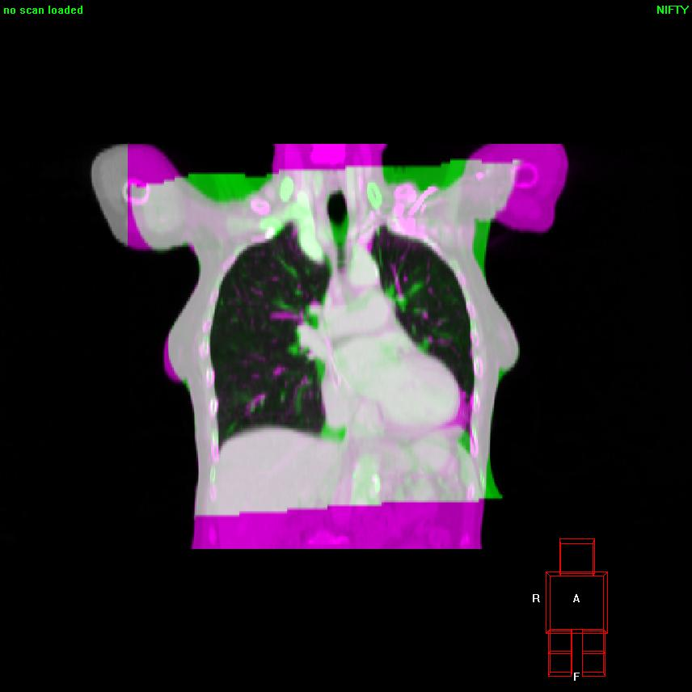
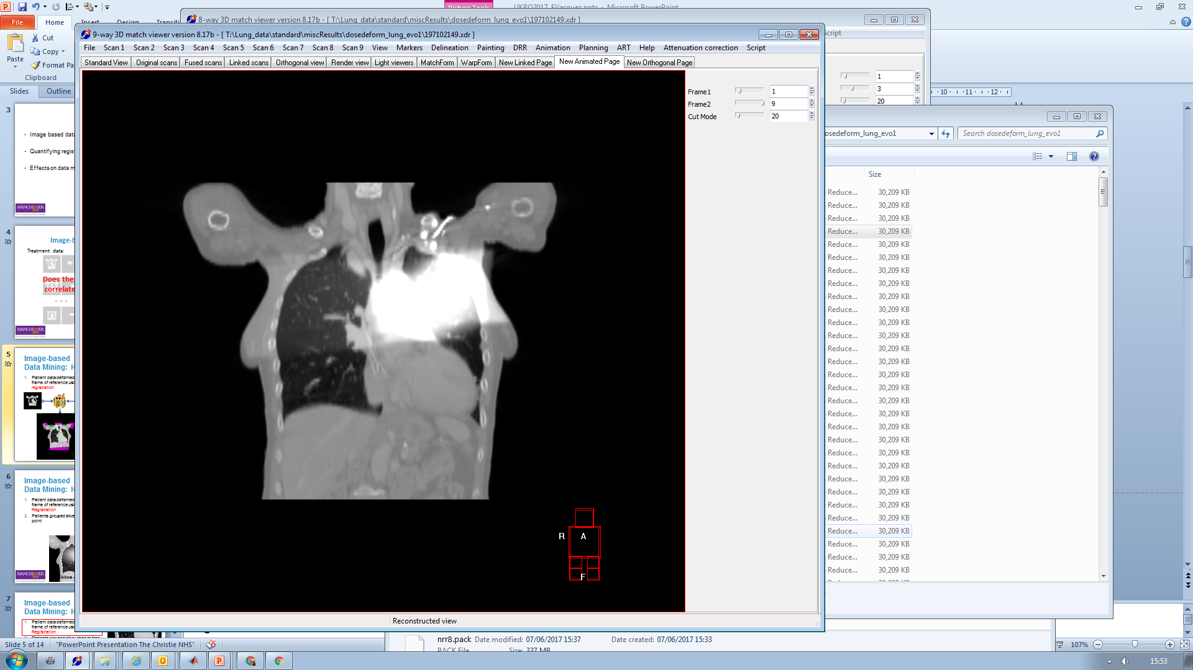
Background: Heart radio-sensitivity
To find these regions of radio-sensitivity, we relied on spatially normalizing all dose distributions to a common anatomy…
Reference patient and 50 mapped dose distributions

Slide 13
Background: Heart radio-sensitivity
To find these regions of radio-sensitivity, we relied on spatially normalizing all dose distributions to a common anatomy… using non-rigid registration.
BUT:
Image registration is not perfect :-/
Impact of choosing the common anatomy?
Impact of large differences in anatomy, e.g. very large vs. very thin patient or large vs small tumours?
Image registration is “slow”

Slide 14
Alternative? New methodology based on machine learning!

Slide 15
How? Transfer learning + Grad-CAM
Follow a novel strategy proposed in 2017 by Zhen and colleagues.
Key aspects:
Transfer learning
Grad-CAM
3D dose flattening
Zhen et al 2017 Phys. Med. Biol. 62 8246

Slide 16

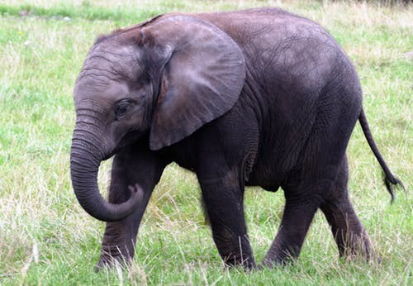
1. Transfer learning
Utilize the learned knowledge from a pre-trained network and apply the trained parameters to a new classification task.
Input:
Natural image
VGG-16 trained on ImageNet
Output:
Image classified in one of 1000 classes
Label: African_elephant
Accuracy: 62.42102384567261
224 x 224
Zhen et al 2017 Phys. Med. Biol. 62 8246

Slide 17
1. Transfer learning
Utilize the learned knowledge from a pre-trained network and apply the trained parameters to a new classification task.
Input:
Radiotherapy data (dose)
VGG-16 trained on ImageNet
Output:
Image classified in one of 2 classes:
Secondary effects experienced
No secondary effects experienced
Label: No secondary effects
Accuracy: 81.18117906878113
Flattened 3D dose
Zhen et al 2017 Phys. Med. Biol. 62 8246

Slide 18
2. Grad-CAM
Visual explanations’ for decisions for a CNN!
Produces a coarse localization map highlighting the important regions in the image for predicting a concept, e.g. cat or dog:
https://arxiv.org/abs/1610.02391

Slide 19
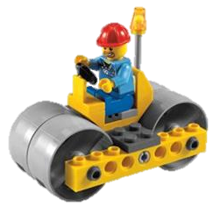
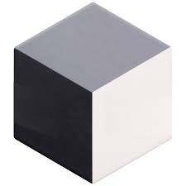
3. Flattening Radiotherapy dose
Zhen and colleagues were looking at secondary effects due to dose to rectums
In our case, we have a cube of radiation dose covering the lung region.
How to flatten it?
You! →

Slide 20
Workshop plan

